Slide 1
Exploratory Data Analysis on QSAR Research
Udit Choudhary

Slide 2
QSAR
Quantitative structure–activity relationship models (QSAR models) are regression or classification models used in the chemical and biological sciences and engineering
In QSAR modeling, the predictors consist of physicochemical properties or theoretical molecular descriptors of chemicals; the QSAR response-variable could be a biological activity of the chemicals. QSAR models first summarize a supposed relationship between chemical structures and biological activity in a data-set of chemicals. Second, QSAR models predict the activities of new chemicals.

Slide 3
Descriptors
Symbol | Descriptor
E2m | 2nd component accessibility directional whim index/weighted by atomic masses
RDF095p | Radial Distribution Function – 9.5/weighted by atomic polarizabilities.
W | Wiener W index
RDF080m | Radial Distribution Function – 8.0/weighted by atomic masses
RDF090u | Radial Distribution Function – 9.0/ unweighted
EEig06x | Eigenvalue 06 from edge adjacency matrix/ weighted by edge degrees

Slide 4
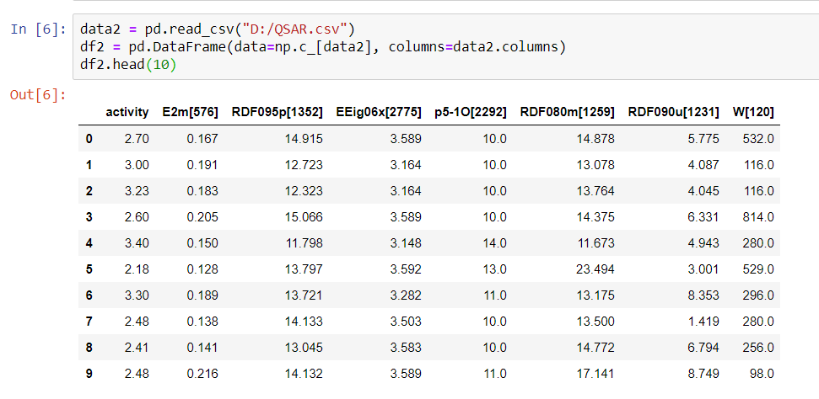

Slide 5
What is a pIC50? It’s the negative log of the IC50 value in molar. Watch:
An IC50 of 1 µM is 10⁻⁶ M, which is pIC50 = 6.0
An IC50 of 1 nM is 10⁻⁹ M, which is pIC50 = 9.0
An IC50 of 10 nM is 10⁻⁸ M, which is pIC50 = 8.0
An IC50 of 100 nM is 10⁻⁷ M, which is pIC50 = 7.0
An IC50 of 30 nM is 3 x10⁻⁷ M, which is also 10^{-7.5} M, which is pIC50 = 7.5

Slide 6
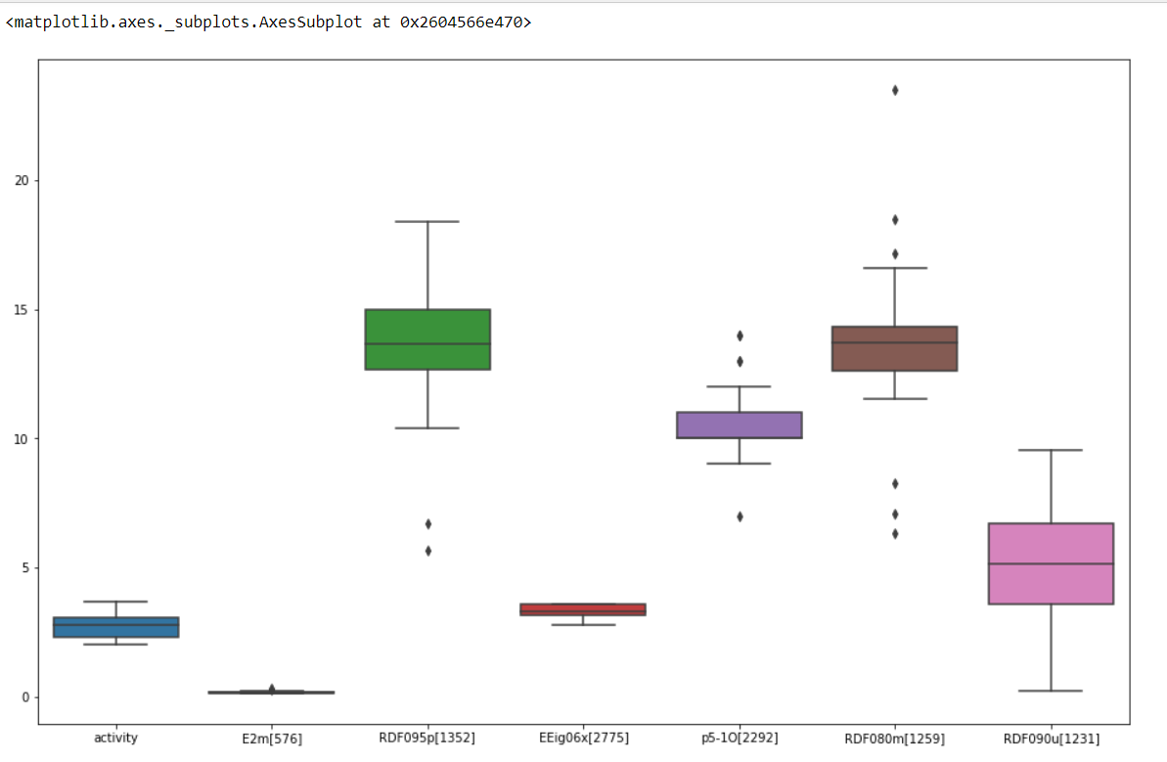

Slide 7
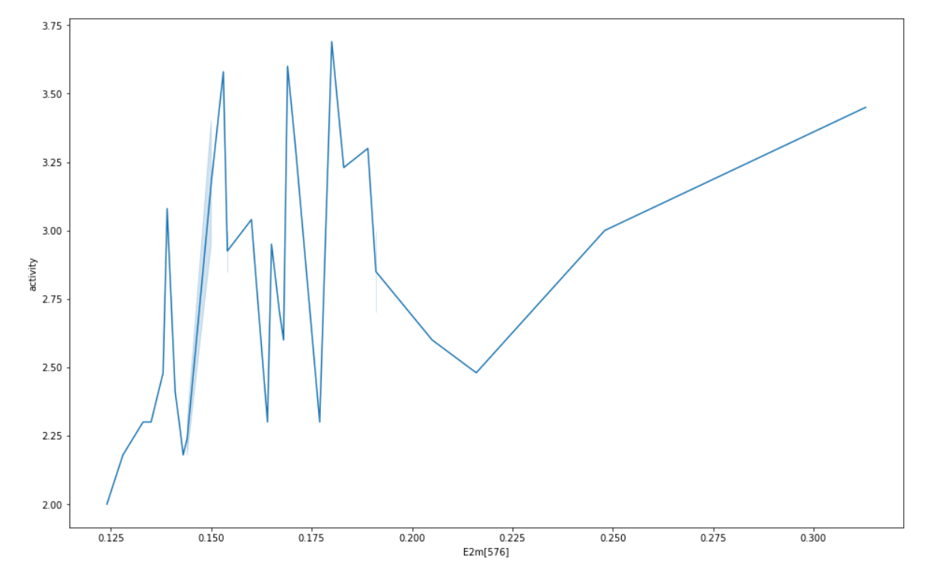
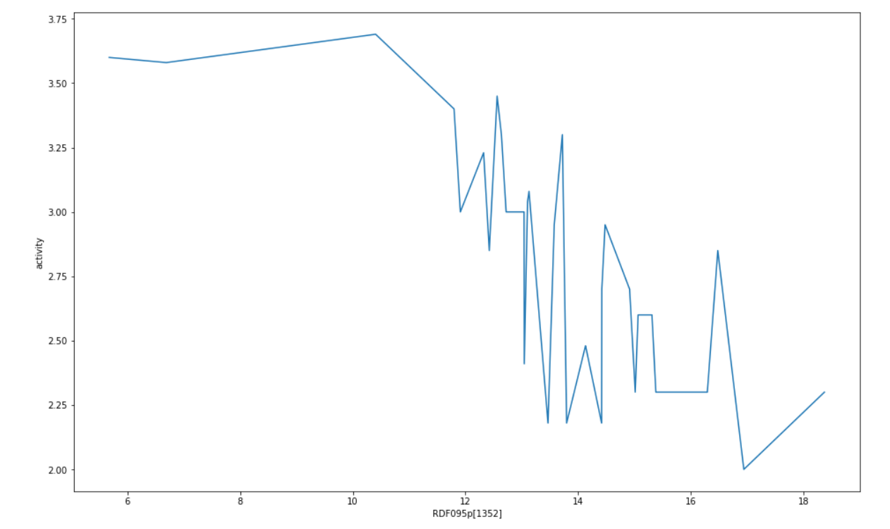
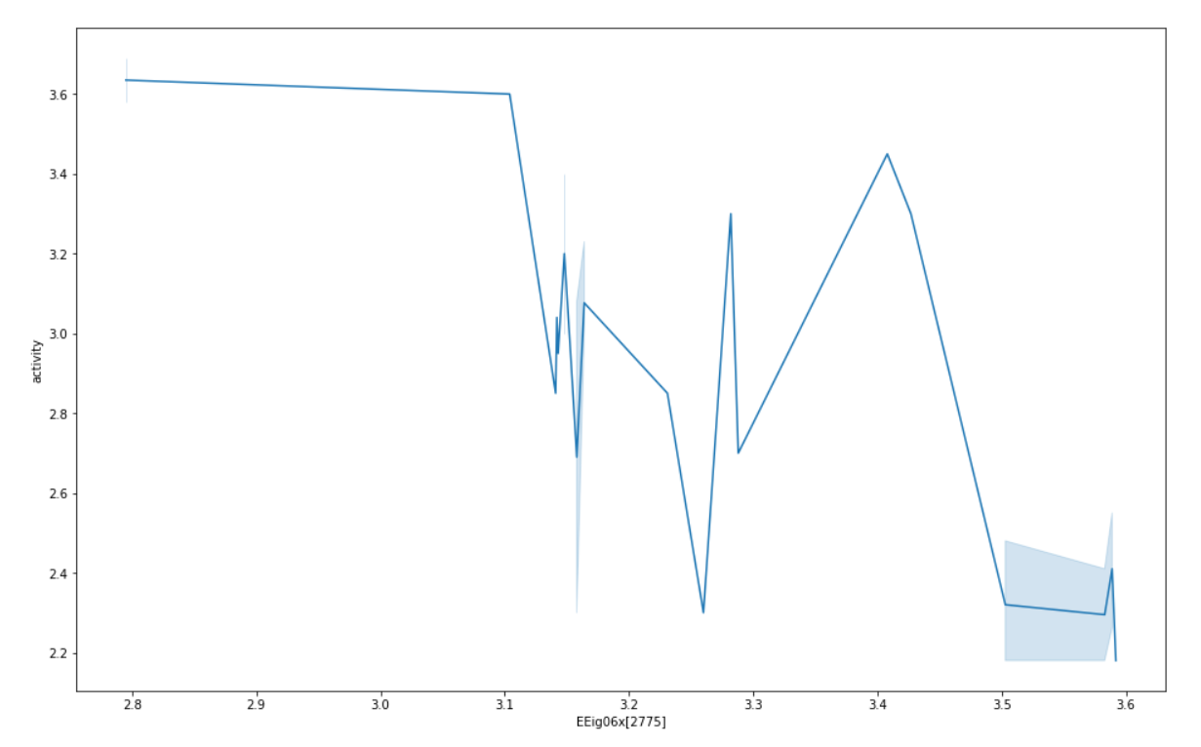
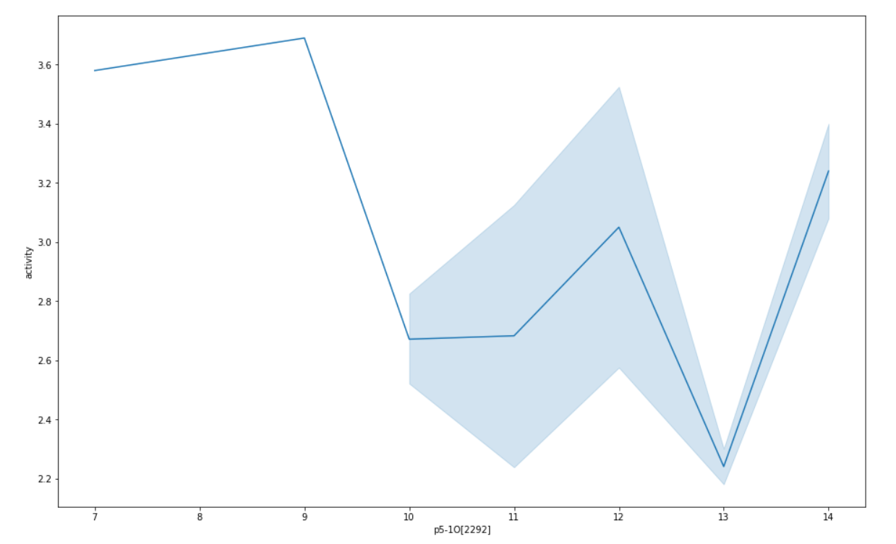
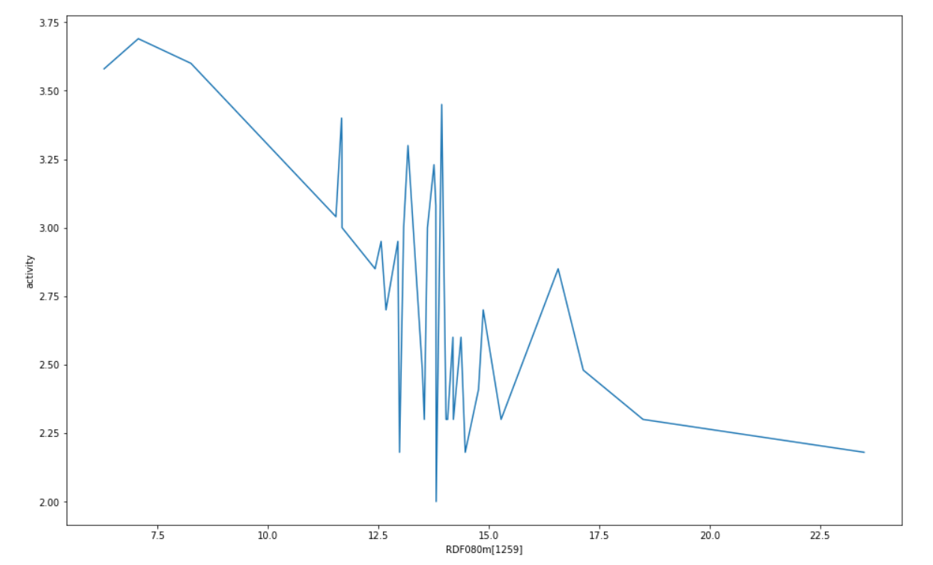
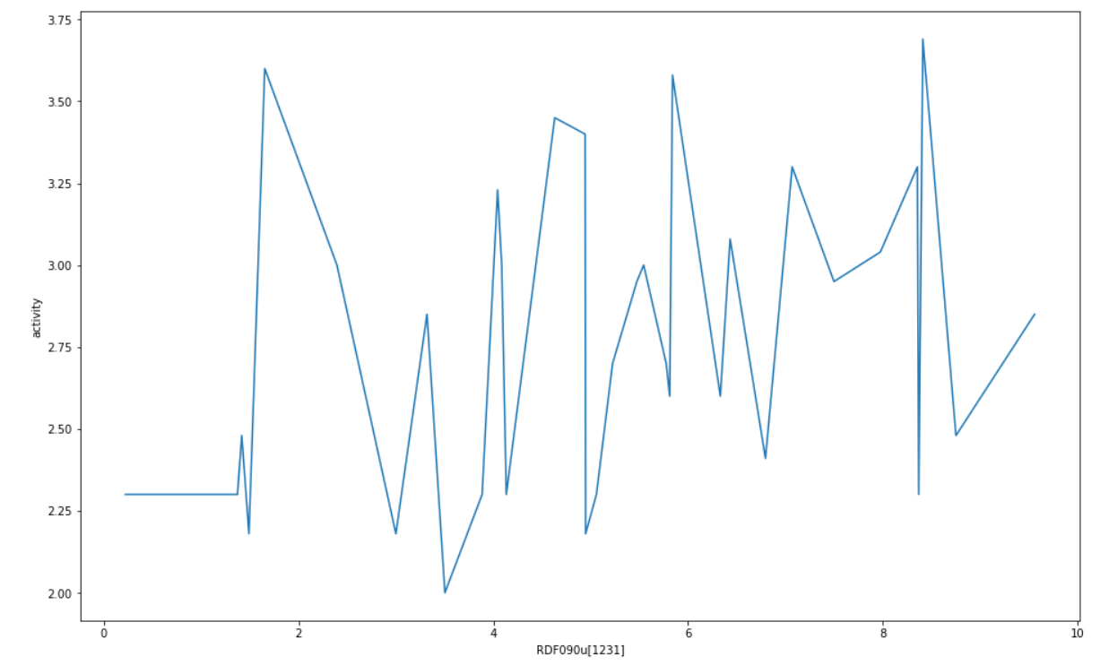
E2m
RDF095p[1352]
EEig06x[2775]
p5-1O[2292]
RDF080m[1259]
RDF090u[1231]

Slide 8
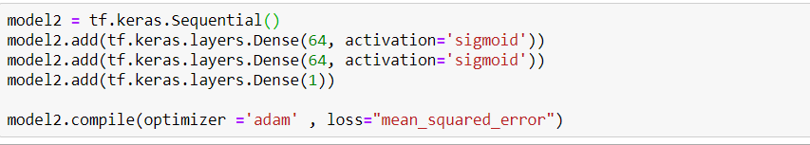
Mean squared error :0.04897386208176613
Predicted Values | Actual Values
2.4914882 | 2.3
3.6071486 | 3.58
2.4630916 | 2.3
3.2320843 | 2.95
2.871802 | 3.23
3.1098342 | 2.85
2.3505015 | 2.18
2.3439388 | 2.3
2.5652707 | 2.3

Slide 9


